Slide 1
Convertorul Analog-Digital
Laborator de Electronica Digitală (ED)
SL. DR. ing. Gabriel Harja
Email: gabriel.harja@aut.utcluj.ro

Slide 2
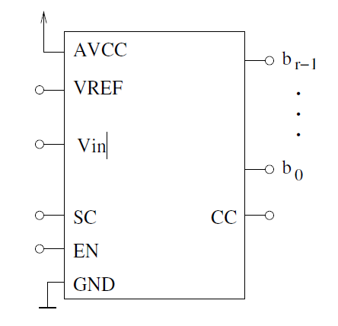
CAN – Convertor analog numeric
[0 ; (2^n)-1]
[0 ;5] V

Slide 3
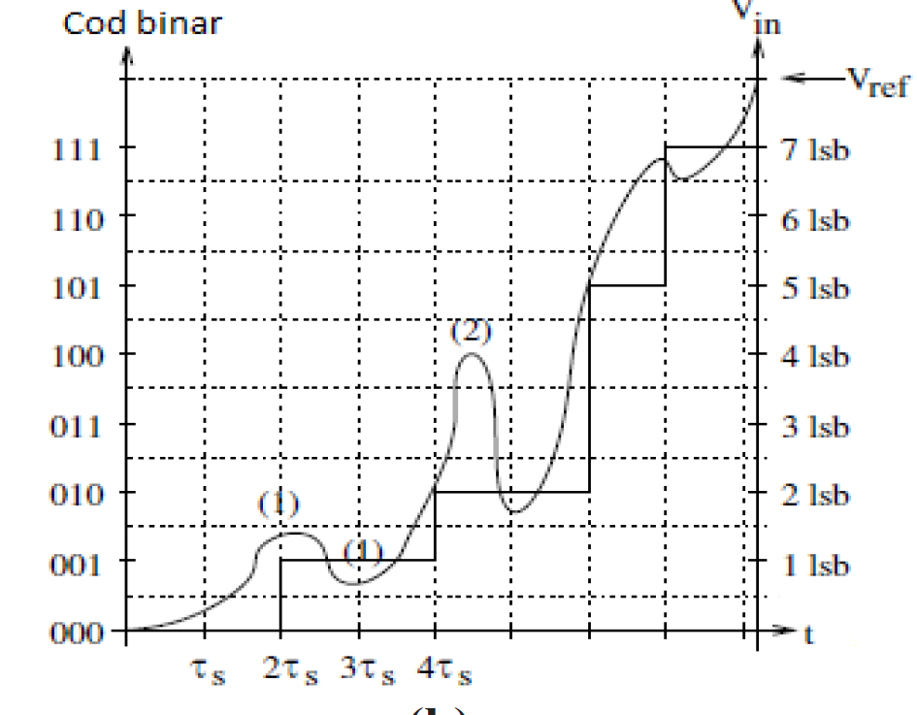

Slide 4
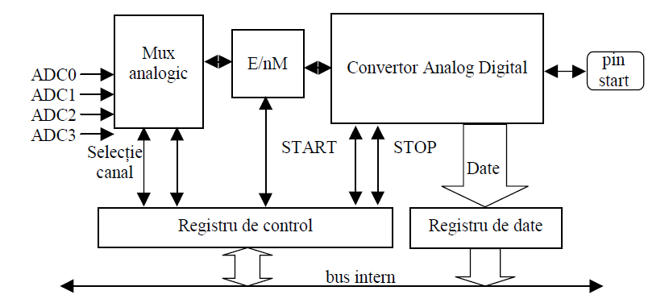
CAN – Convertor analog numeric

Slide 5
Intrerupere a Timerului
void init_adc()
{
ADMUX = 0b01000000;
ADCSRA= 0b10000111;
}
int adc(char ch)
{
ADMUX &= 0b11100000;
ADMUX |= ch;
ADCSRA|=(1<<6);
while(ADCSRA&(1<<6));
return ADC;
}
ISR(TIMER0_COMP_vect)
{ x++;
switch(x)
{ case 1: display(4,n%10);break;
case 2: display(3,(n/10)%10);break;
case 3: display(2,(n/100)%10);break;
case 4: display(1,(n/1000)%10); x=0;break;
}
if (t==999){
n=adc(6);
t=0;
}
else t++;
}

Slide 6
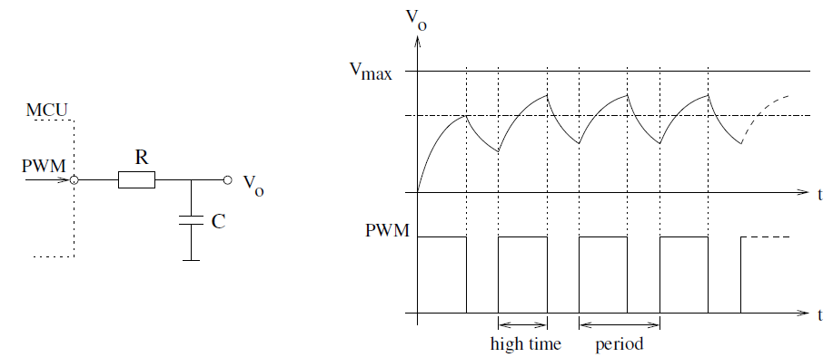
CNA – Convertor numeric Analogic

